Slide 1
Ethical Hacking
Mohona Ghosh

Slide 3

What is Denial of Service Attack ?

Slide 4
Broad Classification for Denial of Service Attack

Slide 5
What is Denial of Service Attack ?
Example of bandwidth attack: Another attack works by generating a huge amount of normal traffic by, for example, running a JavaScript program in a browser that pops up a few dozen windows each fetching a Web page from one server. This may constitute a problem if a few thousand people are willing to run this script in their browser simultaneously. Such a script could easily spread by means of self-replicating e-mail viruses. (This phenomenon can also occur without it being an attack.)

Slide 6

Distributed Denial of Service (DDoS) Attack
A single machine cannot make enough requests to overwhelm network equipment; hence DDoS attacks were created where an attacker uses several computers to flood a victim

Slide 7

Symptoms of DoS Attacks

Slide 8

How DoS/DDoS Attack works ?
A router is a networking device that forwards data packets between computer networks. Routers perform the traffic directing functions on the Internet. A packet is typically forwarded from one router to another router through the networks that constitute an internetwork until it reaches its destination node
When a data packet comes in on one of the lines, the router reads the sender and the destination network address information in the packet to determine the ultimate destination. Then, using information in its routing table or routing policy, it directs the packet to the next network/router on its journey.
The most familiar type of routers are home and small office routers that simply forward IP packets between the home computers and the Internet. An example of a router would be the owner's cable or DSL router, which connects to the Internet through an Internet service provider (ISP). More sophisticated routers, such as enterprise routers, connect large business or ISP networks up to the powerful core routers that forward data at high speed along the optical fiber lines of the Internet backbone.

Slide 9
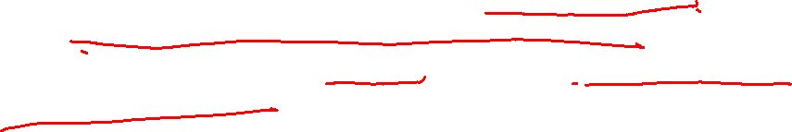

How DoS/DDoS Attack works ?
Most routers have rules in the configuration table that won't allow millions of requests from the same sending address. If too many requests from one address are received in a short period of time, the router simply discards them without forwarding.
Crackers (Non-Ethical Hackers) know this
So they illicitly plant programs on many different computers. These programs, when triggered, begin sending thousands of requests a minute to one or more Web sites. The programs "spoof" the blacklisted IP address of the sender (who is the attacker), placing a different false IP address on each packet so that the routers' security rules wouldn't be triggered.

Slide 10

How DoS/DDoS Attack works ?
When the packet floods are triggered, millions of requests for information begin to hit the targeted Web sites
While the servers are being heavily taxed by the requests, the real impact is to the routers that are just "upstream" from the servers.
Suddenly these routers, which are robust but of a size appropriate for normal traffic, start getting the levels of requests normally associated with Internet backbone routers. They can't handle the massive number of packets, and begin discarding packets and sending status messages to other routers stating that the connection is full
As these messages cascade through the routers leading to attacked servers, all paths to the servers become clogged and legitimate traffic can’t get through the logjam leading to attackers' goals being accomplished.

Slide 11


DoS/DDoS Attack Techniques
Various types of DoS/DDoS Attack Techniques Exist. Few of them are:
Bandwidth Attacks
ICMP Flood Attacks
Service Request Floods
SYN Flooding Attacks
Peer-to-peer Attacks
Permanent Denial of Service Attacks
Application level Flood Attacks

Slide 12

Bandwidth Attacks

Slide 13
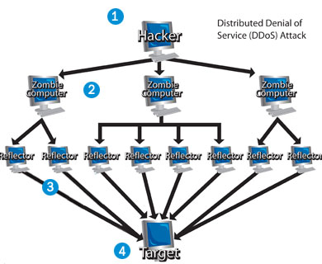

An example of Bandwidth Attacks
Distributed Denial of Service with Reflectors (DRDoS)
The cracker sends the command to initiate the attack to her zombie army.
Each computer within the army sends an electronic connection request to an innocent computer called a reflector with the victim’s IP address as the source IP address.
When the reflector receives the request, it looks like it originates not from the zombies, but from the ultimate (legitimate) victim of the attack.
The reflectors send information to the victim system, and eventually the system's performance suffers or it shuts down completely as it is inundated with multiple unsolicited responses from several computers at once.

Slide 14

An example of Bandwidth Attacks
Distributed Denial of Service with Reflectors (DRDoS)
From the perspective of the victim, it looks like the reflectors attacked the system. From the perspective of the reflectors, it seems like the victimized system requested the packets. The zombie computers remain hidden, and even more out of sight is the cracker herself.
Once an army begins a DDoS attack against a victim system, there are few things the system administrator can do to prevent catastrophe. She could choose to limit the amount of traffic allowed on her server, but this restricts legitimate Internet connections and zombies alike. If the administrator can determine the origin of the attacks, she can filter the traffic. Unfortunately, since many zombie computers disguise (or spoof) their addresses, this isn't always easy to do.

Slide 15


ICMP Flood Attack
In one type of bandwidth attack, attackers use botnets and carry out DDoS attacks by flooding the network with ICMP ECHO packets.
Such attacks are known as ICMP Flood Attacks
The Internet Control Message Protocol (ICMP) is a supporting protocol in the Internet protocol suite.
It is used by network devices like routers to send error messages and operational information indicating for example, that a requested service is not available or that a host or router could not be reached
ICMP packets are also used for locating network equipment and determining the number of hops to get from the source location to the destination

Slide 16
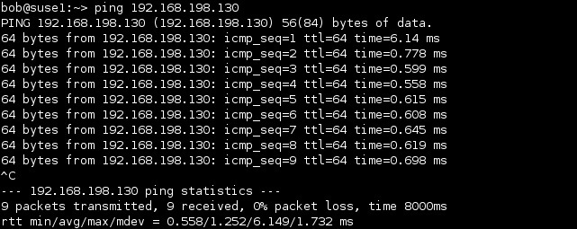

ICMP Flood Attack
For example, every device (such as an intermediate router) forwarding an IP datagram first decrements the time to live (TTL) field in the IP header by one. If the resulting TTL is 0, the packet is discarded and an ICMP time exceeded in transit message is sent to the datagram's source address.
Similarly, ping requests are used to test the connectivity of two computers. For the same, an ICMP echo request is sent that allows the user to send a request to a destination system and in return receive a response - ICMP echo reply with the roundtrip time.

Slide 17

ICMP Flood Attack
An ICMP request requires the server to process the request and respond, so it takes CPU resources.
A DDoS ICMP flood attack occurs when zombies send large volumes of ICMP_ECHO request packets to a victim system without waiting for reply
These packets signal the victim's system to reply, and the combination of traffic saturates the bandwidth of the victim's network connection. The source IP address is spoofed.
After the ICMP threshold is reached, the router rejects further ICMP echo requests from all addresses in the same security zone thereby leading to legitimate ICMP echo requests being also dropped

Slide 18


ICMP Flood Attack
There are a number of ping commands that can be used to facilitate such an attack, for example:
The –n command, which is used to specify the number of times a request is sent
The –l command, which is used to specify the amount of data sent with each packet
The –t command, which is used to continue pinging until the host times out.
The –w command is used to indicate timeout in milliseconds to wait for each reply.
It is most successful if the attacker has more bandwidth than the victim (for instance an attacker with a DSL line of 2GBPS speed and the victim on a dial-up modem with 25mbps speed)

Slide 19
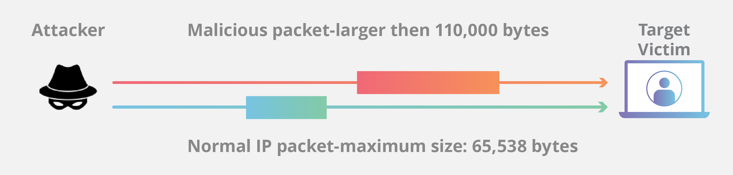

ICMP Flood Attack
Ping of Death Attack
A correctly-formed ping packet is typically 56 bytes in size, or 64 bytes when the Internet Protocol header is considered.
However, any IPv4 packet (including ping packets) may be as large as 65,536 bytes.
Many computer systems are not designed to properly handle a ping packet larger than the maximum packet size because it violates the Interne Protocol documented in RFC 79
So, when a ping of death packet (ping packet of larger size) is sent from a source computer to a target machine, the ping packet gets fragmented into smaller groups of 8 octet packets.
When these packets reach the target computer, they arrive in fragments. So, the target computer reassembles the malformed packets which are received in chunks.
But, the whole assembled packet causes buffer overflow at the target computer
This buffer flow often causes the system crash making the system more vulnerable to attack. Once the system becomes more vulnerable to attack, it allows more attacks like the injection of a trojan horse on the target machine.

Slide 20


Ping of Death Attack
Here are the steps of this attack:
Open Notepad
Copy the following text on the notepad
:loop ping <IP Address> -l 65500 -w 1 -n 1 goto :loop
In the above command, replace <IP Address> with an IP address.
Save the Notepad with any name. Let’s say dos.txt
Right click on the dos.txt and click on rename.
Change the extension from .txt to .bat
So, now the file name should be dos.bat
Double click on it and you will see a command prompt running with a lot of pings.

Slide 21
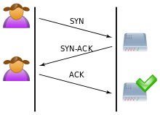


Syn Flood Attack
Normally when a client attempts to start a TCP connection to a server, the client and server exchange a series of messages which normally runs like this:
The client requests a connection by sending a SYN (synchronize) message to the server
The server acknowledges this request by sending SYN-ACK back to the client
The client responds with an ACK and the connection is established
This is called the TCP three-way handshake, and is the foundation for every connection established using the TCP protocol

Slide 22


Syn Flood Attack
When server receives the SYN request from client, it must keep track of the partially-opened connection in a "listen queue" for at least 75 seconds to get the ACK packet back
This is because sometimes simple network congestion could also be the cause of the missing ACK

Slide 23


Syn Flood Attack
A malicious host can exploit the small size of the listen queue by sending multiple SYN requests to a host, but never responding to the server with the expected ACK code
The malicious client can either simply not send the expected ACK, or by spoofing the source IP address in the SYN causing the server to send the SYN-ACK to a falsified IP address - which will not send an ACK because it knows that it never sent a SYN

Slide 24
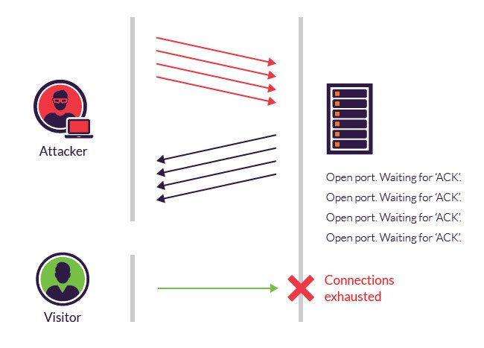


Syn Flood Attack
During this time, the server cannot close down the connection by sending an RST packet, and the connection stays open. Before the connection can time out, another SYN packet will arrive. This leaves an increasingly large number of connections half-open
In this attack, the half open connections created by the malicious client bind resources on the server and may eventually exceed the resources available on the server.
It works by filling the table reserved for half open TCP connections in the server operating system's TCP IP stack . When the table becomes full, new connections cannot be opened until and unless some entries are removed from the table ( due to handshake timeout ) .
At that point, the server cannot connect to any clients, whether legitimate or otherwise. This effectively denies service to legitimate clients. Some systems may also malfunction or crash when other operating system functions are starved of resources in this way.
https://www.cloudflare.com/learning/ddos/syn-flood-ddos-attack/

Slide 25
Permanent Denial of Service Attack

Slide 26

Botnets

Slide 27
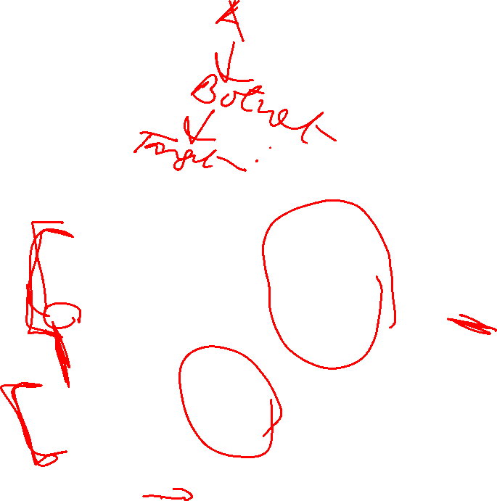
Botnets based DoS Attacks
In order to perform this kind of attack, the attacker first needs to create a botnet.
For this purpose, the attacker infects a machine, i.e., victim bot, and compromises it.
He or she then uses the victim bot to compromise some more vulnerable systems in the network.
Thus, the attacker creates a group of compromised systems known as a botnet.

Slide 28
Botnets based DoS Attacks
The attacker configures a bot command and control (C&C) center and forces the botnet to connect to it.
The zombies or botnet connect to the C&C center and wait for instructions.
The attacker then sends commands to the bots through C&C to launch DoS attack on a target server.
Thus, he or she makes the target server unavailable or non-responsive for other genuine hosts in the network.

Slide 29
DOS Detection Techniques
When large amounts of expected or unexpected traffic from legitimate clients suddenly arrive at a system, it’s called a flash event
How can an administrator differentiate between a legitimate and illegitimate flood packet requests ?
The detection techniques for DoS attacks are based on identifying and discriminating the illegitimate traffic increases and flash events from legitimate packet traffic
Use some statistics to differentiate
All detection techniques define an attack as an abnormal and noticeable deviation from a threshold of normal network traffic statistics

Slide 30
DOS Detection Techniques
3 techniques
Activity profiling
Change-point detection, and
Wavelet-based signal analysis

Slide 31
Activity Profiling
Typically, an activity profile can be obtained by monitoring header information of a network packet
An activity profile is defined as the average packet rate for network flow . It consists of consecutive packets with similar packet fields (such as address, port, and protocol)
The activity level or average packet rate of flow is determined by the elapsed time between the consecutive packets.
For statistical analysis, large number of packets are required (of the order of 2⁶⁴)
To analyse such large number of packets, packets are usually divided into clusters
An attack is then indicated by either increasing activity levels among a particular clusters or an increase in the overall number of distinct clusters, which can represent many distributed attacking agents (as in a DDoS).

Slide 32
Activity Profiling Example
Usually in denial-of-service attack, the attacker spoofs (or forges) the source address in IP packets sent to the victim. In general, the victim machine cannot distinguish between the spoofed packets and legitimate packets, so the victim responds to the spoofed packets as it normally would. These response packets are known as backscatter.
If the attacker is spoofing source addresses randomly, the backscatter response packets from the victim will be sent back to random destinations. This effect can be used by network telescopes as indirect evidence of such attacks.
The term "backscatter analysis" refers to observing backscatter packets arriving at a statistically significant portion of the IP address space to determine characteristics of DoS attacks and victims
The backscatter packets’ source address is that of the victim, but the packet’s destination address is randomly spoofed.
To detect attacks, the destination address distribution uniformity of a cluster is analysed against regular traffic

Slide 33
DoS/DDoS Countermeasures Strategies

Slide 34
DoS/DDoS Countermeasures

Slide 37
Botnet Architecture (Agent Handler Model)

Slide 38
DoS/DDoS Countermeasures

Slide 39
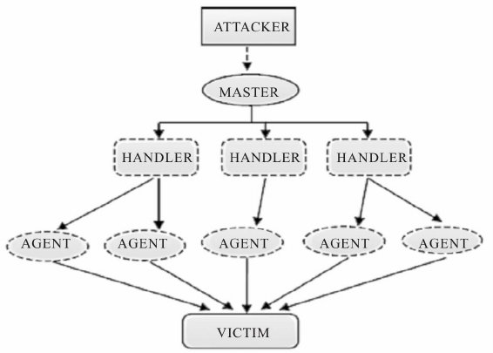
Botnet Architecture (Agent Handler Model)
Botnet Architecture to carry out DDoS

Slide 40
DDoS Architecture (Agent Handler Model)
The compromised computer systems (bots) are referred to as agents
The attacker also uses a separate layer of computer systems – referred to as handlers – as the command and control (C&C) system to manage the agents

Slide 41
DDoS Architecture (Agent Handler Model)
The attacker communicates with the handlers to establish command and control
Typically, a handler is a powerful server with plenty of resources (bandwidth, memory and processing power)
In addition to receiving commands from the attacker, the handler is responsible for keeping track of agents and sending commands including configurations and updates to the agents

Slide 42
DDoS Architecture (Agent Handler Model)
The owner of the compromised machine has no knowledge that an agent program has been installed in their machine or that they are part of botnet
The agent software usually comes in form of Trojan or malware
The attacker uses agents as stepping stones to launch attacks against the victims

Slide 43
DDoS Architecture (Agent Handler Model)
A limitation of this architecture is that attackers must be able to communicate with handlers and handlers must be able to contact the agents
If the attackers lose the communication, possibly by implementation of new network filtering rules, the attackers lose control of the agents and thus cannot orchestrate the agents to attack a new target

Slide 46
DoS/DDoS Countermeasures

Slide 47
At its simplest, ingress filtering involves establishing an access control list that contains the Internet Protocol addresses (IP addresses) of permitted source addresses. Conversely, the access control list may also be used to block prohibited source addresses.
Ingress filtering takes advantage of the Layer 2 IP address filtering capability of a router at the network's edge and blocks traffic that has a high probability of being malicious. It makes this determination based on whether the contents of an IP packet header meet defined criteria. The packet filter examines several attributes, most notably in this case the source IP address. If the source address is invalid -- that is, if it doesn't match its originating network -- the filter determines the address is forged (or "spoofed") and drops the packet.

Slide 48
Source IP addresses that are commonly blocked with ingress filter include:
IP addresses that are already in use as an IP address within the internal network. This helps prevent an attacker from spoofing an internal IP address to take advantage of a poorly written firewall rule.
IP addresses that are loopbacks. This helps prevent traffic from an attacker who is spoofing a loopback address to take advantage of a poorly written firewall rule base.
IP addresses that are multicast addresses. This helps prevent undesired multicast traffic that is likely to be spam.
IP addresses that are service or management network addresses. This helps prevent an attacker from using the public internet to gain unauthorized access to network services running at the network application layer and above.
Additionally, network administrators may want to whitelist traffic from specific regions of the world that their organization does business with or blacklist dangerous regions of the world that their company prefers to not access its environment. There are several free and subscription-based services that can be used to create access control lists for network border routers.

Slide 49
DoS/DDoS Countermeasures: Detecting potential attacks
Ingress filtering is one type of packet filtering. Its counterpart is egress filtering, which is used to examine outbound traffic and only allows packets to leave the network if they meet predetermined policies set by an administrator. Egress filtering is used to prevent malicious activity, such as infected machines attempting to leak data to remote hosts, or to block legitimate users from accessing prohibited services, such as online gaming sites.

